Slide 1

Analytics
Unit V

Slide 2
Course Content
Unit V
Image Processing
Analytics
Facebook
Twitter
Web Programming
Flask
DJango

Slide 3
Image Processing
Computer Vision
Digital
Enhance Image
Smoothening
Sharpening
Contrast
Stretch
Restoration

Slide 4
Applications
Original Image
Zoom
Blur
Sharp
Edges

Slide 5
Medical
Gamma Ray
PET Scan
X-Ray
CT Scan
UV Imaging

Slide 6
AI
Object Detection
Line Follower
Face Recognition
Face Identification

Slide 7
Other Applications
Color
Pattern
Video

Slide 8
Image Processing Python Libraries
Open CV
4.5.2
Numpy
1.20.0
Scipy
PIL
Matplotlib
1.6.3
8.2.0
3.4.1

Slide 9
GrayScale
import cv2
image = cv2.imread('sist.jpg')
cv2.imshow('Original', image)
cv2.waitKey()
gray_image = cv2.cvtColor(image, cv2.COLOR_BGR2GRAY)
cv2.imshow('Grayscale', gray_image)
cv2.waitKey(0)
cv2.destroyAllWindows()

Slide 10
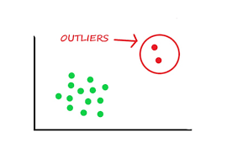
Image Blur
Remove outlier pixels in the image

Slide 11
Approaches
Averaging
Gaussian Blurring
Median Blurring
Bilateral Filtering

Slide 12
Image Blurring
import cv2
img = cv2.imread('sist.jpg')

Slide 13
Averaging Approach
avging = cv2.blur(img,(10,10))
cv2.imshow('Averaging',avging)
cv2.waitKey(0)

Slide 14
Gaussian Approach
gausBlur = cv2.GaussianBlur(img, (5,5),0)
cv2.imshow('Gaussian Blurring', gausBlur)
cv2.waitKey(0)

Slide 15
Median Blurring
medBlur = cv2.medianBlur(img,5)
cv2.imshow('Median Blurring', medBlur)
cv2.waitKey(0)
medBlur = cv2.medianBlur(img,9)
cv2.imshow('Media Blurring', medBlur)
cv2.waitKey(0)

Slide 16
Bilateral Filtering
bilFilter = cv2.bilateralFilter(img,9,75,75)
cv2.imshow('Bilateral Filtering', bilFilter)
cv2.waitKey(0)

Slide 17
Histogram
Intensity Distribution of an image
Plot with pixel values (0 to 255)

Slide 18
Histogram Implementation
import cv2
from matplotlib import pyplot as plt
img = cv2.imread('sathyabama.jpg',0)
histr = cv2.calcHist([img],[0],None,[256],[0,256])
plt.plot(histr)
plt.show()

Slide 19
Edge Detection
Image Processing Technique
To find the boundary of objects within images
By detecting discontinuities in brightness
Approach – Canny Edge Detector

Slide 20
Edge Detection - Image
import cv2
import matplotlib.pyplot as plt
image = cv2.imread("sist.jpg")
gray = cv2.cvtColor(image, cv2.COLOR_BGR2GRAY)
plt.imshow(gray, cmap="gray")
plt.show()
edges = cv2.Canny(gray, threshold1=30, threshold2=100)
plt.imshow(edges, cmap="gray")
plt.show()

Slide 21
Edge Detection – Live Cam
import cv2
cap = cv2.VideoCapture(0)
while True:
_, frame = cap.read()
gray = cv2.cvtColor(frame, cv2.COLOR_BGR2GRAY)
edges = cv2.Canny(gray, 30, 100)
cv2.imshow("edges", edges)
cv2.imshow("gray", gray)
if cv2.waitKey(1) == ord("q"):
break
cap.release()
cv2.destroyAllWindows()

Slide 22
Analysis
Statistical Approach
Machine Learning Algorithm
Artificial Intelligence
Deep Learning Technique

Slide 23


Analysis

Slide 24
Types of Analysis
Exploratory
Data and Figure
Noteworthy
Point of Interest
Explanatory
Pearls from Oysters
Specific
Highlight the importance
Correlation
Data Distribution

Slide 25
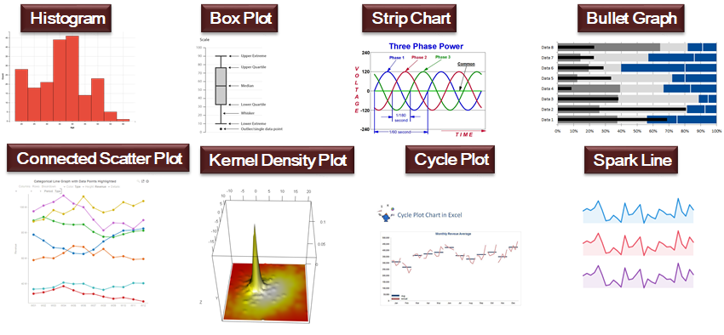
Exploratory Data Analysis

Slide 26
Text Analysis (Natural Language Processing - NLP)
Facebook
Twitter
Whatsapp
Telegram
Feedback / Comments

Slide 27
Facebook
https://www.facebook.com
https://developers.facebook.com/apps
https://developers.facebook.com/tools/explorer

Slide 28
Facebook and Python
pip install facebook-sdk
from facebook import GraphAPI
my_access_token = “……”

Slide 29
from facebook import GraphAPI
my_access_token = “ACCESS CODE OF THE FACEBOOK APP"
graph = GraphAPI(access_token = my_access_token)
print(graph)
profile = graph.get_object('me',fields='id, first_name, posts{message, name, id},likes')
print(profile)
posts = graph.get_connections(profile['id'], 'posts', limit=10)
print(posts)
likes = graph.get_connections(profile['id'], 'likes', limit=10)
print(likes)

Slide 30
Iterate through likes
for like in likes:
for d in likes[like]:
if type(d) is dict:
print()
for x in d:
print(d[x], end=" ")

Slide 31
Write to JSON
import json
with open("facebook.json","w") as of:
json.dump(likes["data"], of, indent=4)

Slide 32
Write to MongoDB
import pymongo
myclient = pymongo.MongoClient("mongodb://localhost:27017")
mydb = myclient["fbdemo"]
mycol = mydb["fbcol"]
for like in likes:
for d in likes[like]:
if type(d) is dict:
mycol.insert_one(d)
myclient.close()

Slide 33
Twitter
https://www.twitter.com
https://developer.twitter.com/
pip install TwitterAPI

Slide 34
Keys (OAuth)
Open Authorization Framework
1.0
2.0
API Key
API Key Secret
Access Token
Access Token Secret
Bearer Token

Slide 35
Twitter & Python
# -*- coding: utf8 -*-
from TwitterAPI import TwitterAPI
SEARCH_TERM = ['#bigdata', '#AI', '#datascience', '#machinelearning', '#ml', '#iot']
CONSUMER_KEY = "YOUR CONSUMER KEY"
CONSUMER_SECRET = "YOUR CONSUMER SECRET KEY"
ACCESS_TOKEN = "YOUR APP ACCESS TOKEN"
ACCESS_TOKEN_SECRET ="YOUR APP ACCESS TOKEN SECRET"
api = TwitterAPI(CONSUMER_KEY, CONSUMER_SECRET, ACCESS_TOKEN, ACCESS_TOKEN_SECRET)
r = api.request('search/tweets', {'q': SEARCH_TERM})
for item in r:
print(item['text'] if 'text' in item else item)

Slide 36
Twitter to MongoDB
import pymongo
myclient = pymongo.MongoClient("mongodb://localhost:27017")
mydb = myclient["twitterdemo"]
mycol = mydb["twittercol"]
for item in r:
mycol.insert_one(item)

Slide 37
Web Programming using Python
Flask
Django

Slide 38
Flask
Easy to use
Inbuilt development server and debugger
Integrated unit testing support
RESTful request dispatching (Representational State Transfer)
Jinja2 templating
Support for secure cookies (client side sessions)
100% WSGI 1.0 compliant (Web Server Gateway Interface)
Unicode based

Slide 39
Simple Web App
from flask import Flask
app = Flask(__name__)
@app.route("/")
def hello():
return "Hello World!"
if __name__ == "__main__":
app.run()
pip install flask
localhost:5000

Slide 40
URL Route
Redirection
Create 3 url route
index
home
home/<variable> [Dynamic Routing]

Slide 41
Routing Example
from flask import Flask
app = Flask(__name__)
@app.route("/")
def index():
return "<h1>Landing Page<h1>"
@app.route("/home")
def home():
return "<h2>At Home page</h2>"
@app.route("/<name>")
def user(name):
return f"<h3>hi {name}</h3>"
@app.route("/home/<name>")
def homeuser(name):
return f"<h1>hi {name}</h1>"
if __name__ == "__main__":
app.run()

Slide 42
Template
@app2.route("/hello/<name>/")
def hello(name):
return render_template('test.html',name=name)

Slide 43
test.html
<!DOCTYPE html>
<html lang="en">
<head>
<meta charset="UTF-8">
<title>SIST</title>
</head>
<body>
<h1>Dept. of {{name}}</h1>
</body>
</html>

Slide 44
Template
@app2.route("/dept/<dept>/")
def dept(dept):
return render_template('test2.html’, dept=dept, batch=["2017-2021", "2018-2022", "2019-2023", "2020-2024"])

Slide 45
test2.html
<div>
<p>Dept. of {{ dept }}</p>
<p>{{ batch }}</p>
<p>Batches:</p>
<ul>
{% for b in batch %}
<li>{{ b }}</li>
{% endfor %}
</ul>
</div>

Slide 46
Layout
<title>SIST</title>
<style>
@import url(http://fonts.googleapis.com/css?family=Amatic+SC:700);
body { text-align: center; }
h1 { font-family: 'Amatic SC', cursive; font-weight: normal;
color: #8ac640; font-size: 2.5em; }
h2 { font-family: 'Arial'; font-weight: strong;
color: #831238; font-size: 5.5em;}
</style>
{% block body %}{% endblock %}

Slide 47
static & layout
{% extends "layout.html" %}
{% block body %}
<div class="block1">
<h2>Sathyabama</h2>
<h1>Hello {{name}}!</h1>
<img src="{{url_for('static', filename='sist.jpg')}}" align="middle" />
<br>Learn Today. Lead Tomorrow
</div>
{% endblock %}

